Slide 1

VISCOSITY

Slide 2
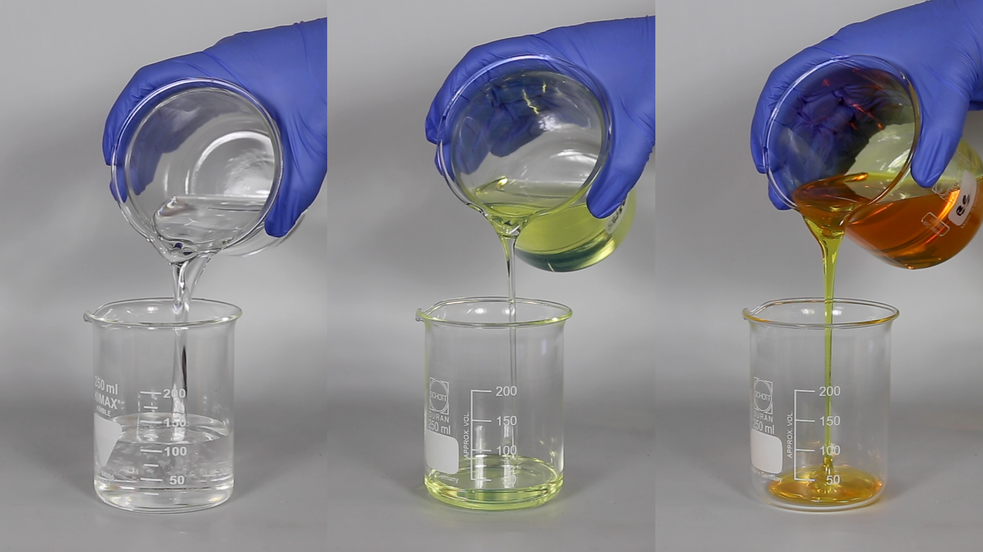
I NOTICE/I WONDER
Eurol Lubricants (2020). Thin, thinner, thinnest: The trend towards low-viscosity engine oils. Eurol.com. https://eurol.com/en/thin-thinner-thinnest-the-trend-towards-low-viscosity-engine-oils/
Notes:
Encourage students to note color and thickness of each substance.

Slide 3


VISCOSITY
Questions:
1. Would you expect a liquid with a high viscosity to flow faster or slower than a liquid with a low viscosity?
2. Rank the following liquids in order from lowest to highest viscosities:
Syrup
Molasses
Water
Honey
Cooking oil
Viscosity is the measure of a liquid’s resistance to flow.
Notes:
Emphasize that viscosity is not the ability to flow but the resistance to flow. This is a common misconception.

Slide 4

Viscosity Lab Time
Lets measure the impact of temperature on viscosity

Slide 5
DISCUSSION
Did the molasses have a higher or lower viscosity than corn syrup?
Which temperature of corn syrup had the highest viscosity, and which had the lowest viscosity?
How did water impact the viscosity of corn syrup?

Slide 6
DISCUSSION
Based on what we learned about composition and temperature of magmas, would felsic or mafic lava have higher viscosity?
Based on what you know about the viscosity of mafic magma, what type of volcanic eruption would you expect?
Based on what you know about the viscosity of felsic magma, what type of volcanic eruption would you expect?
Notes:
If students are struggling to come up with answers to the first question, remind them of the temperature and the type of minerals in each type of magma. If students are struggling to come up with answers to the second question, give them hints about more viscous liquids struggling to come out of the container and pressure building up.

