Slide 1

Fractional Crystallization

Slide 2

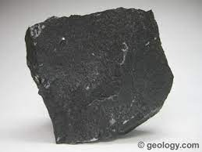
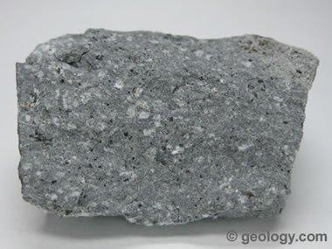
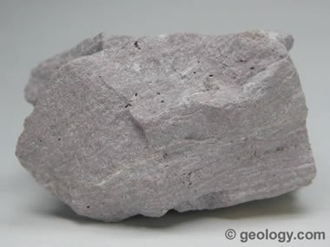
I notice/I wonder
Notes:
The picture on the left is a basalt, the center is an andesite, and the right is a rhyolite. If you have samples of these rock types available, passing these around can add engagement to the lesson.

Slide 3
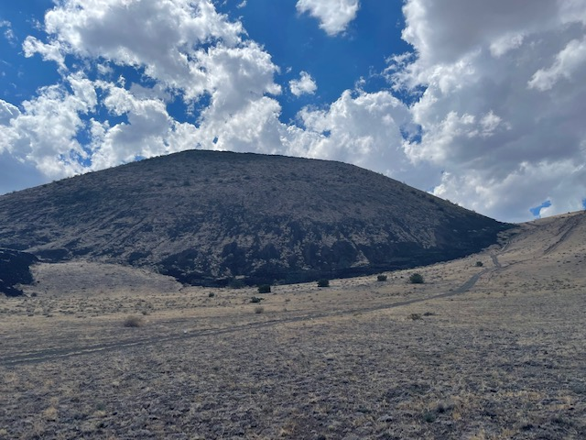
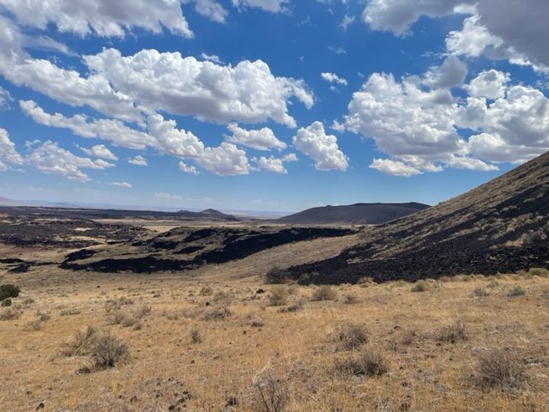
S-P Crater

Slide 4
Magma Types
Ultramafic: mostly olivine and pyroxene, very high melting point, mantle material
Mafic: high in iron, calcium, and magnesium, less olivine more amphibole than ultramafic, high melting point
Intermediate: high in biotite mica and potassium feldspar, medium melting point
Felsic: high in silica, potassium, and sodium, high in quartz, muscovite mica, and potassium feldspar, low melting point
Questions:
How do you think magma changes from ultramafic magma from the mantle to felsic magma?
What patterns do you notice?

Slide 5
Fractional Crystallization
As magma moves toward the surface, the temperature decreases allowing it to cool.
Higher melting point minerals will crystallize out first and sink.
Each time it cools, more minerals crystallize out.
Questions:
What types of magmas have the higher melting points?
Based on this, what types of minerals do you think would crystallize out first?

Slide 6
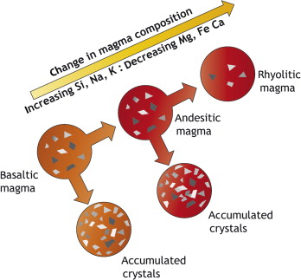
Changing Magma Composition
As magma moves towards the surface, it has an increases in silica, sodium, and potassium and a decreases in magnesium, iron, and calcium.
This allows for the formation of more intermediate and felsic magmas.

Slide 7
Why are There Sometimes Different Compositions Erupted at the Surface?
Rate of Upwelling
Magmas can move quickly from extreme depths to the surface.
This process does not always allow time for minerals to crystalize out.
Therefore, when the rate of upwelling is fast, composition of the magma will not be impacted by fractional crystallization.
This allows for mafic to intermediate magmas to be produced.
Pressure
As pressure decreases, melting increases resulting in less fractional crystallization.
This allows more mafic magmas to erupt at the surface, especially at mid-ocean ridges where pressure is low
Notes:
Teachers can ask students what would happen at subduction zones?
Answer: melting occurs a depth and magma has to work its way up through rock to the surface resulting in more fractional crystallization and more felsic magmas

Slide 8
References
Slide 2:
King, Hobart M. (2005). Basalt: What Is Basalt, How Does It Form, and How Is It Used? Geology.com, https://geology.com/rocks/basalt.shtml
King, Hobart M. (2005). Andesite. Geology.com, https://geology.com/rocks/andesite.shtml
King, Hobart M. (2005). Rhyolite: An extrusive igneous rock with a very high silica content. Geology.com, https://geology.com/rocks/rhyolite.shtml
Slide 3:
Anderson, Stephanie (2022). Photos of S-P Crater. Personal Collection.
Slide 6:
Rogers, Nich (2015). Chapter 4-The Composition and Origins of Magma. The Encyclopedia of Volcanoes (Second Edition), Academic Press, ISBN 9780123859389, https://www.sciencedirect.com/science/article/pii/B9780123859389000043

